Slide 1

MoodMentor
AI-Based Employee Wellness Management Platform
Write how your day feels. Get an emotion estimate, practical habits and a view of your trends.
Md. Ayesha Afreen
Frontend
Shamya S Shetty
Backend
Priaanka Avanigadda
Database
Durga Surya Teja
AI / ML
Vankudothu Divya
Testing
Notes:
Welcome everyone. We are a team of five and this is MoodMentor, an AI-based employee wellness platform. Each of us built one part: frontend, backend, database, AI/ML and testing. In the next minutes we will show the idea, how the parts connect, and a live result from the running system.

Slide 2

Why MoodMentor?
What we set out to build
THE PROBLEM
Stress and tiredness build up quietly. Most people notice only when it already feels heavy.
A calm, easy-to-use web app
An emotion estimate with a stress score
Short, practical wellness suggestions
We wanted a private, easy daily check-in that gives something useful back.
Trends and feedback over time
One connected system built by five people
Notes:
People often notice stress late. We wanted a private daily check-in that is easy to use and gives something useful back. These five goals guided everything we built.

Slide 3



How it works
1
2
3
4
Write
Analyze
Recommend
Track
Describe how the workday feels in a few sentences
The model estimates Stress, Fatigue, Calm or Positive
Three short habits that match the emotion
History, trends and feedback over time
Real example: "I am so tired and drained" → Fatigue (62%)
Notes:
This is the whole journey in four steps. The person writes, the model analyzes, the app recommends, and the dashboard tracks. The example at the bottom is real output from our model: the sentence 'I am so tired and drained' gives Fatigue at 62 percent.

Slide 4




Meet the team
Md. Ayesha Afreen
Frontend
Built the React interface: 7 sections, charts, breathing tool and a live-backend switch
Shamya S Shetty
Backend
Built the FastAPI backend: 4 endpoints that connect the model and the database
Priaanka Avanigadda
Database
Designed the SQLite database: 4 tables, sample data and trend queries
Durga Surya Teja
AI / ML
Trained the emotion model (TF-IDF + Logistic Regression) and wrote its tests
Vankudothu Divya
Testing
Test plan, API and model tests, failure checks and bug reports
Notes:
One person owns each module, and everyone worked in their own folder of one shared GitLab repository. Introduce yourselves briefly: name, module, and one sentence about what you built.

Slide 5
System architecture
Frontend
Backend
AI model
React + Vite
Runs in the browser on port 5173
FastAPI + Uvicorn
REST API on port 8000
TF-IDF + Logistic Reg.
JSON
Database
SQLite, 4 tables
The frontend only talks to the backend. The backend calls the model and saves to the database.
Notes:
Four layers. The React app in the browser sends JSON to the FastAPI backend. The backend calls the machine learning model and stores everything in SQLite. The rule that kept our work clean: the frontend only talks to the backend, never directly to the model or database.

Slide 6
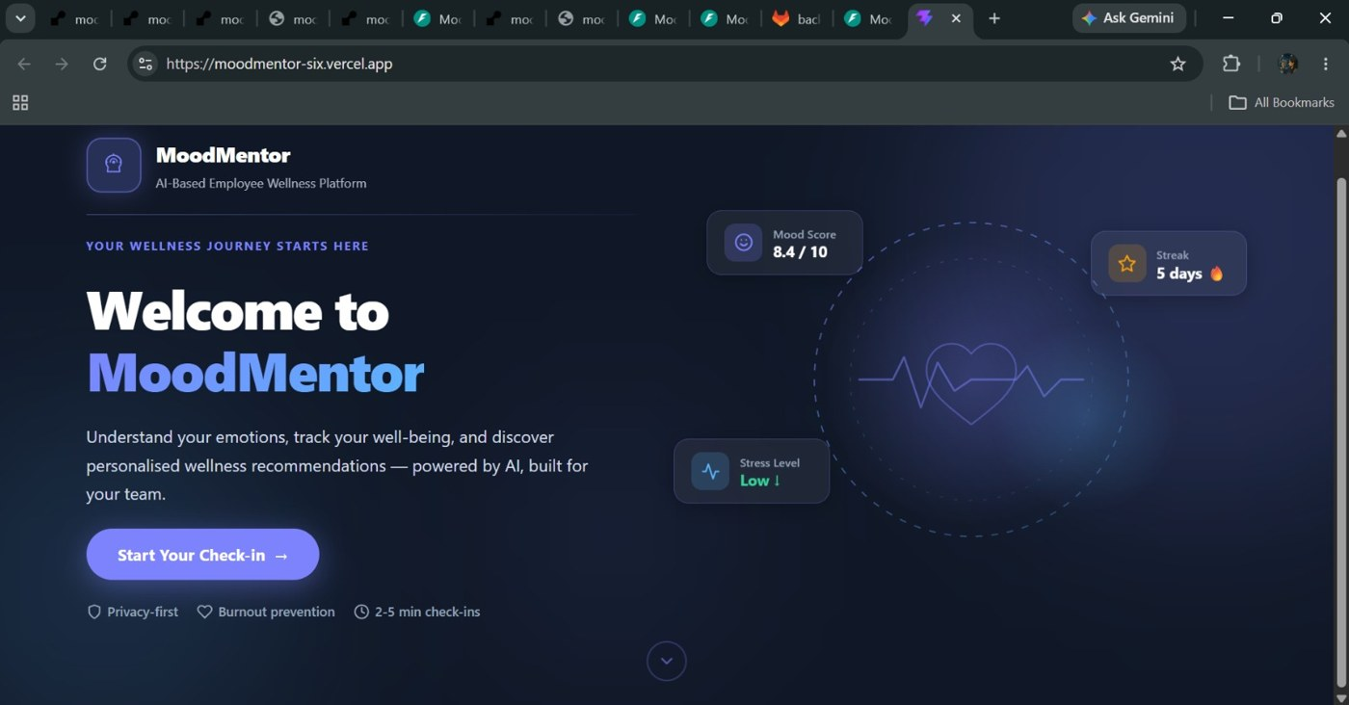
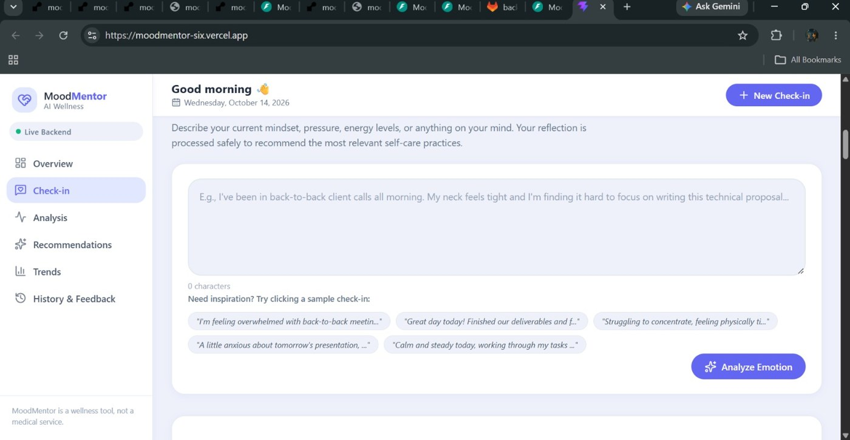
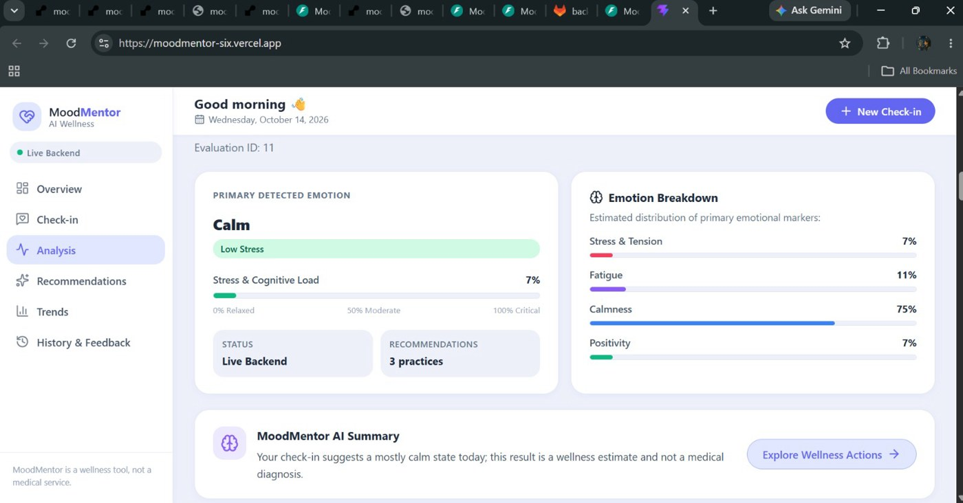
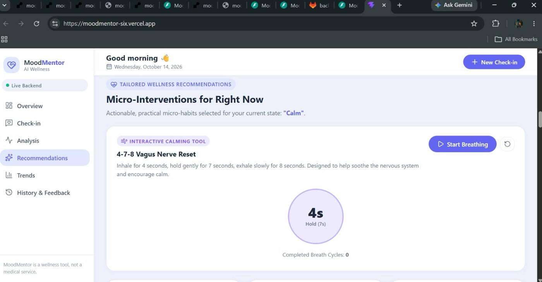
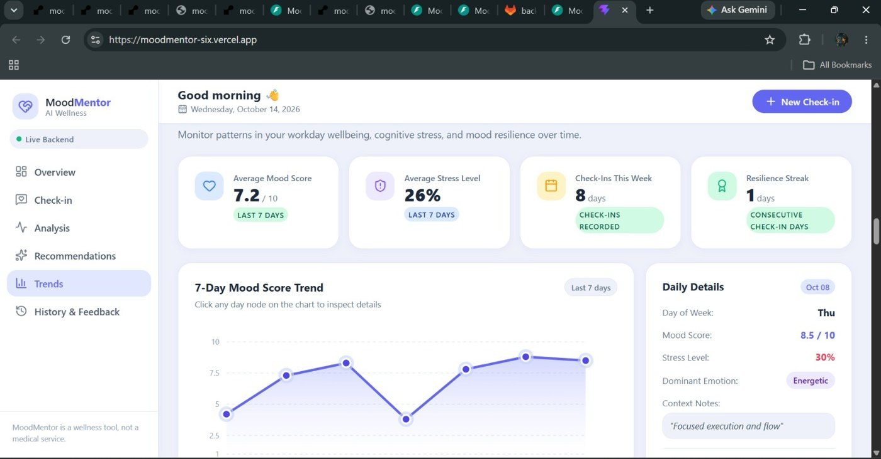
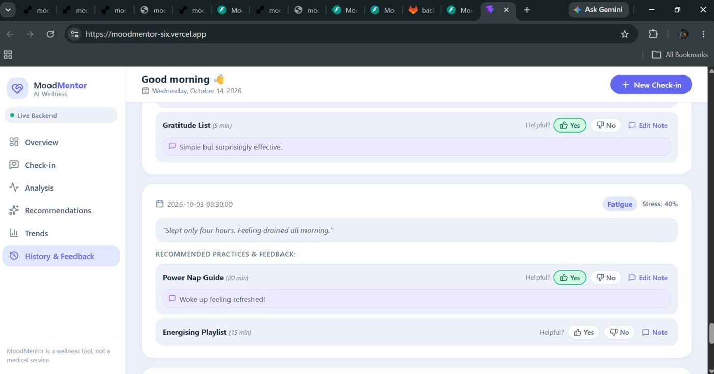
Total workflow
1 Home page
2 Check-in
3 Analysis
4 Recommendations
5 Trends
6 History & Feedback

Slide 7
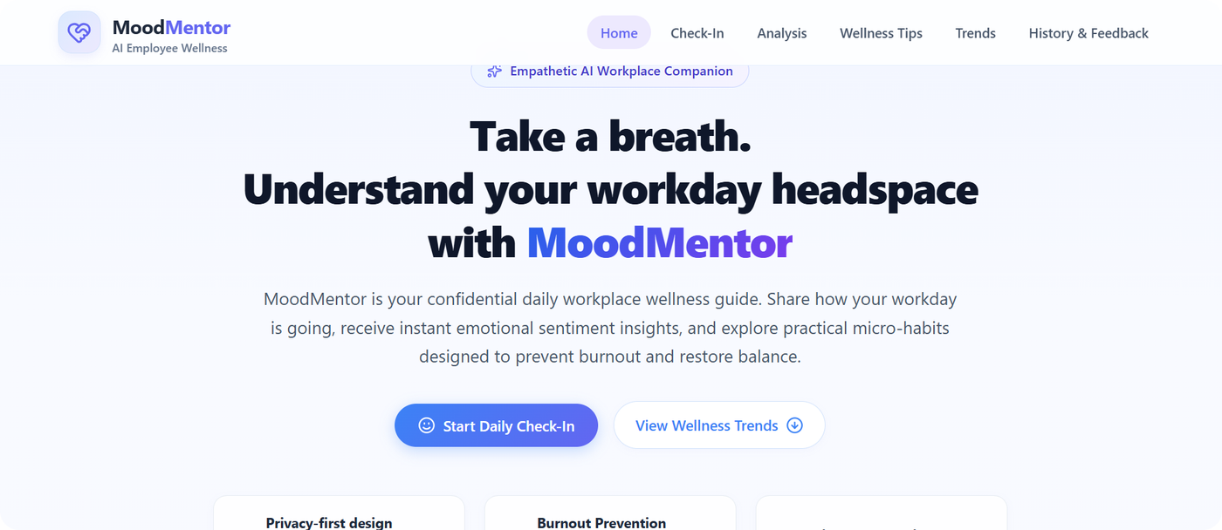
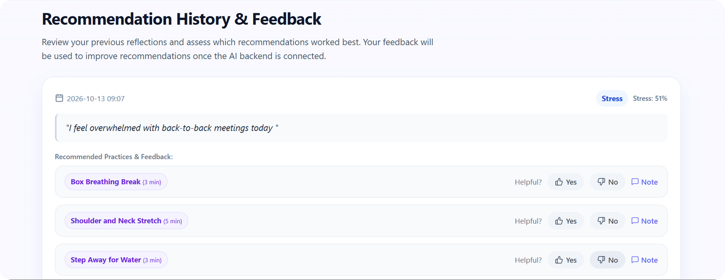
Frontend
Md. Ayesha Afreen · Frontend
Seven sections: home, check-in, results, tips, trends, history and feedback
Calm pastel blue, lavender and white design that also works on phones
Custom SVG trends chart and an interactive 4-7-8 breathing tool
One setting switches between sample data and the live backend
Honest wording and a medical disclaimer on the page
Notes:
I built the user interface with React and Vite. It has seven sections and a calm pastel design. A trends chart is drawn from scratch in SVG, and there is a breathing tool. One setting in a configuration file switches the app between sample data and the live backend, so we could build before the backend was ready. We also removed claims a prototype cannot support and added a disclaimer.

Slide 8
Backend
Shamya S Shetty · Backend
POST
GET
Under the hood
/api/analyze-emotion
/api/trends
Rejects empty text and text over 2000 characters
CORS lets the React app call the API
Swagger page at /docs for testing
Builds mood score, balance and streak for trends
Analyse text, save it, return emotion and tips
Last 7 days of mood, stress and balance
GET
POST
/api/history
/api/feedback
Past check-ins with their feedback
Save Helpful or Not Helpful and a note
Notes:
The backend is written in Python with FastAPI. It has four endpoints that follow the JSON contract we agreed as a team. It validates input, calls the model, saves to the database and builds the numbers for the trends chart. FastAPI gives a free test page at slash docs, which we used to check every endpoint.

Slide 9
Database
Priaanka Avanigadda · Database
TABLE
TABLE
TABLE
TABLE
users
checkins
recommendations
feedback
id · name · email
text · emotion · four scores · mood · date
title · duration · category · description
helpful · note · date
4
tables with keys and constraints
7
days of sample check-ins for the first run
4
emotion labels enforced by the database
Notes:
The database is SQLite because it needs no server and works on every laptop. There are four tables: users, check-ins, recommendations and feedback. The database itself only accepts our four emotion labels. A seed file loads seven days of sample check-ins so the trends chart has something to show on the first run. The generated database file is kept out of Git.

Slide 10

AI / Machine Learning
Durga Surya Teja · AI / ML
Your text
TF-IDF features
Logistic Regression
Stress · Fatigue · Calm · Positive
88%
0.88
200
1.4 ms
accuracy on 50 held-out sentences
macro F1-score
synthetic training sentences
per prediction
Prototype: small synthetic dataset. Wellness estimates only, not a diagnosis.
Notes:
The model turns the text into TF-IDF features and classifies it with Logistic Regression into four emotions. On a held-out test of 50 sentences it reached 88 percent accuracy and a macro F1 of 0.88. We want to be honest: the 200 training sentences are synthetic and written for this project, so this is a prototype and the 88 percent does not describe real employee text. One prediction takes about 1.4 milliseconds.

Slide 11

Testing
Vankudothu Divya · Testing
Model: sample sentences, empty text and non-English text
13/17
API: valid, empty, very long and special-character input
planned checks passed so far; the other 4 are being completed
Full flow: browser to backend to database and back
All 4 emotions predicted
API returns valid JSON
Failures: a friendly message when the backend is stopped
Live result in the browser
Notes:
Testing covers the model, the API, the whole flow and failure cases. So far 13 of the 17 planned checks have passed, including all four emotions predicted correctly, valid JSON from the API and a live result in the browser. The remaining four checks are being completed: empty and very long text, feedback saved after a refresh, the backend stopped, and phone screen width.

Slide 12
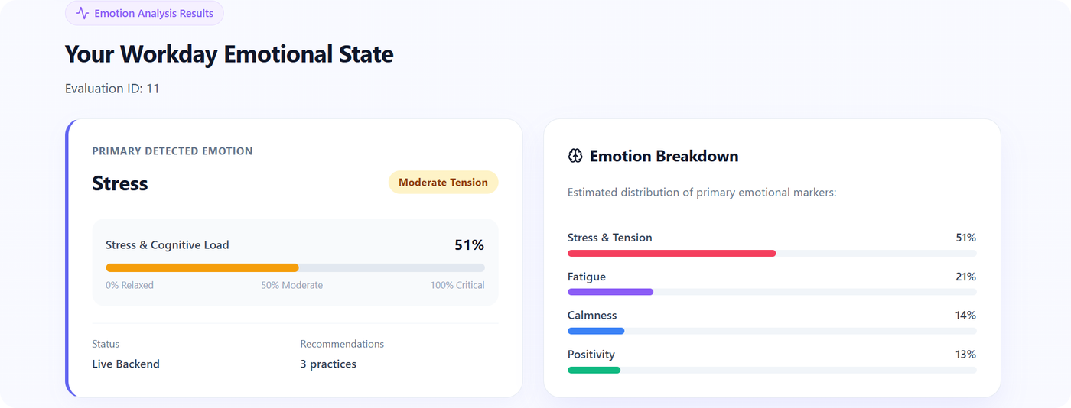
The result, live
Stress at 51%, estimated by the trained model
1
Status: Live Backend, not sample data
2
Typed: "I feel overwhelmed with back-to-back meetings today"
Saved as check-in 11 in the database
3
Notes:
This is real output from the running system, not a mock-up. I typed one sentence, the frontend sent it to the backend, the model estimated Stress at 51 percent, and the result was saved as check-in 11 in the database. The status line says Live Backend, which means this is not sample data.

Slide 13
How we worked together
1
2
3
4
Agree the API contract
Build in parallel
Merge with merge requests
Connect and test
Same JSON, labels and ports for everyone
Own folder and own branch for each person
Frontend, database, backend, then ML
Run together, fix, repeat
One GitLab repository, one branch per person
frontend-initial
Md. Ayesha Afreen
database-initial
Priaanka Avanigadda
backend-initial
Shamya S Shetty
ml-initial
Durga Surya Teja
Notes:
Our rule was simple: agree the data format first, then each person builds in their own folder on their own branch. Work reached the main branch only through GitLab merge requests, in the order frontend, database, backend and ML. Then we connected everything and tested it together.

Slide 14


Problems we solved
Model crashed silently
Website showed sample data
Cause: a beta Python version. Fix: use a stable Python release.
A setting in .env was still true. We set it to false and restarted.
Edits landed in the wrong folder
SQL import failed in PowerShell
We worked only inside the cloned repository folder.
PowerShell has no < redirect, so we used Python's sqlite3.
Notes:
These are real problems we hit and fixed. A silent crash turned out to be a beta version of Python. The website kept showing sample data because one setting still said true. Some edits went to an old folder. And a database import command did not work in PowerShell. Each one taught us to check the basics first.

Slide 15

Limits and what's next
Honest limits
Next steps
Small synthetic dataset, so 88% is not real-world accuracy
Four broad emotions and English only
No login: one demo user
Runs locally and is not deployed yet
Real, consented data and stronger models
Secure login and an anonymous team-level view
Cloud deployment with a managed database
More languages and crisis-safe responses
MoodMentor is a wellness support tool, not a medical service. It does not diagnose conditions.
Notes:
We want to be clear about the limits. The data is small and synthetic, there are only four broad emotions, there is no login and it runs locally. The next steps are real data with consent, stronger models, secure login with an anonymous team-level view, cloud deployment and more languages. MoodMentor is a wellness support tool and not a medical service.

Slide 16
Thank you
Questions?
A small team, a clear contract, one working system.
Md. Ayesha Afreen
Frontend
Shamya S Shetty
Backend
Priaanka Avanigadda
Database
Durga Surya Teja
AI / ML
Vankudothu Divya
Testing
Notes:
Thank you for listening. In one line: a small team, a clear contract between the parts, and one working system. We are happy to take questions, and each of us can answer about our own module.

